Slide 1
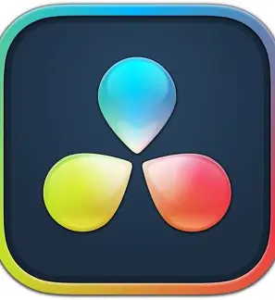


AjeditsDB
Online Freelancing
Video Editing Business
on Fiverr
By AJ Luthra

Slide 2
Ajeditsdb
Ajedits26 is a freelancing video editing online business hosted on fiverr, and it offers viral short-form and long-form edits with clean animations and motion graphics. The software I use to edit every project is called Davinci Resolve. A client clicks on my gig page and views the description, chooses a pricing package ranging from Basic, Standard, Premium, they can look at reviews from previous clients, and can browse sample projects. Clients will send a message to the seller to discuss requirements or ask about my skills, click order now, provide detailed project instructions/deadlines, and remain in real-time constant contact with sellers to track work progress.

Slide 3
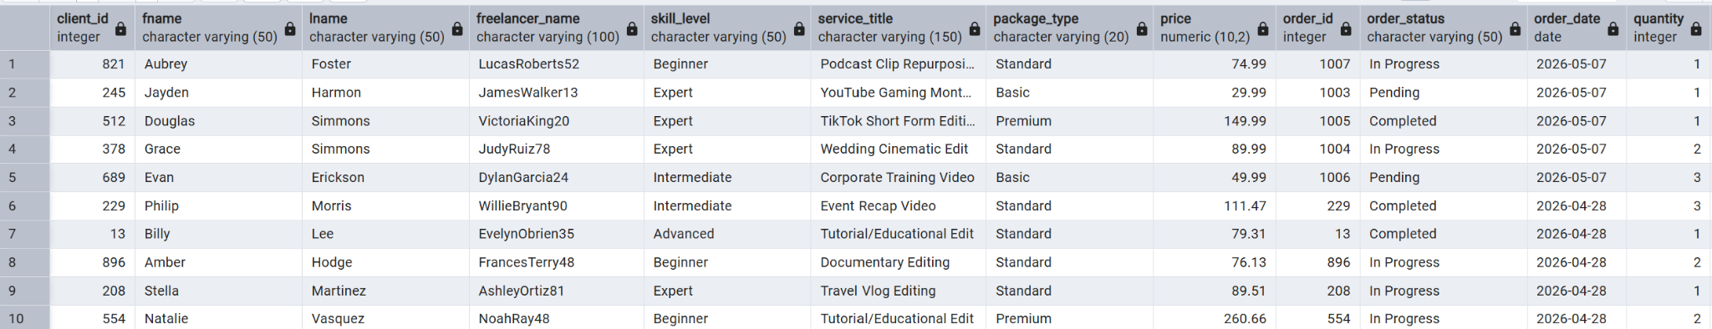
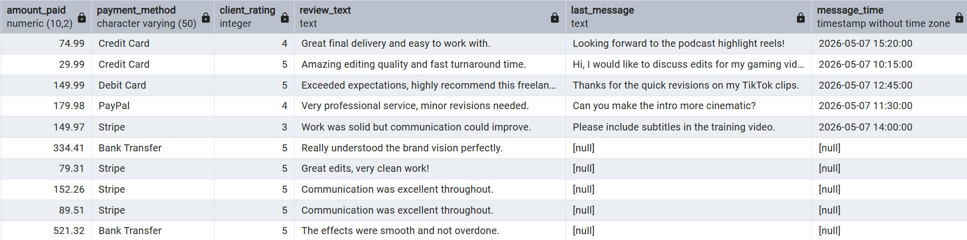
Data (Using Joins to view all tables)

Slide 4
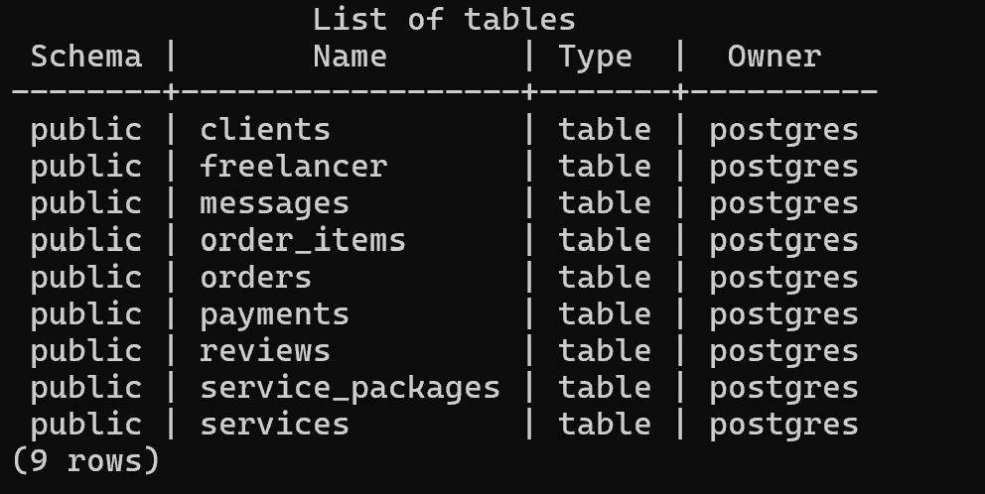
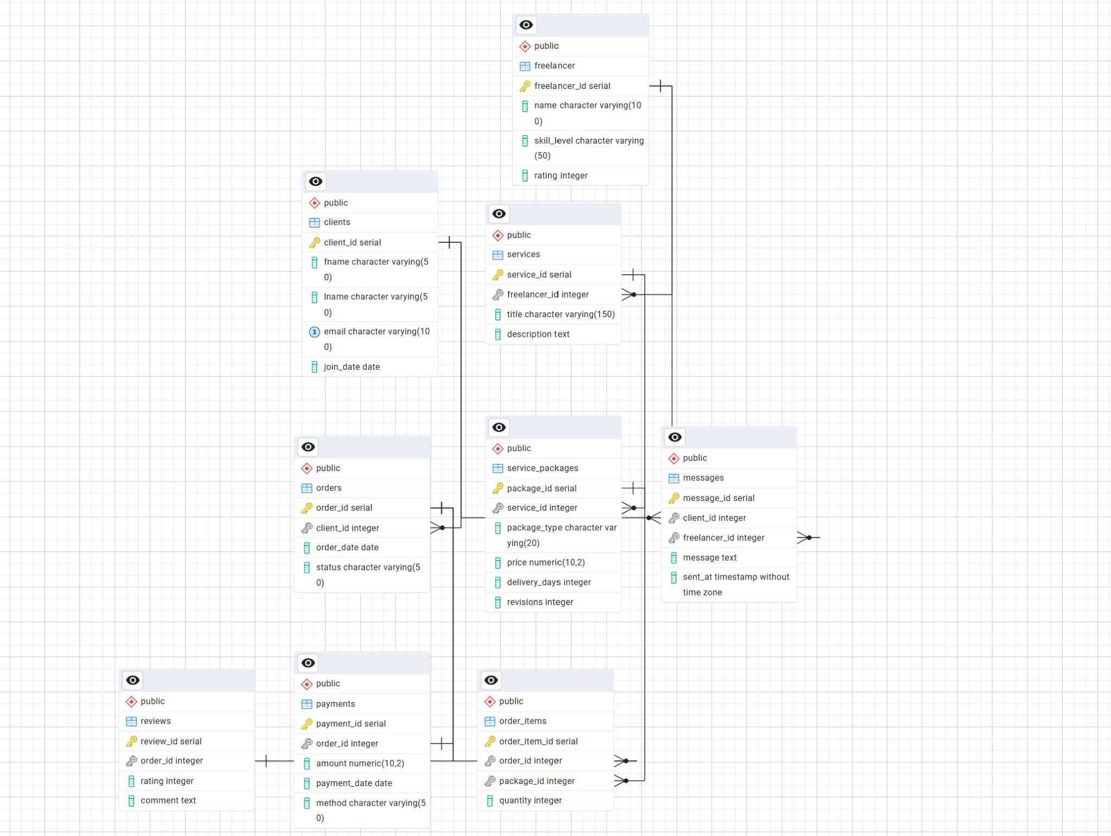
Tables

Slide 5
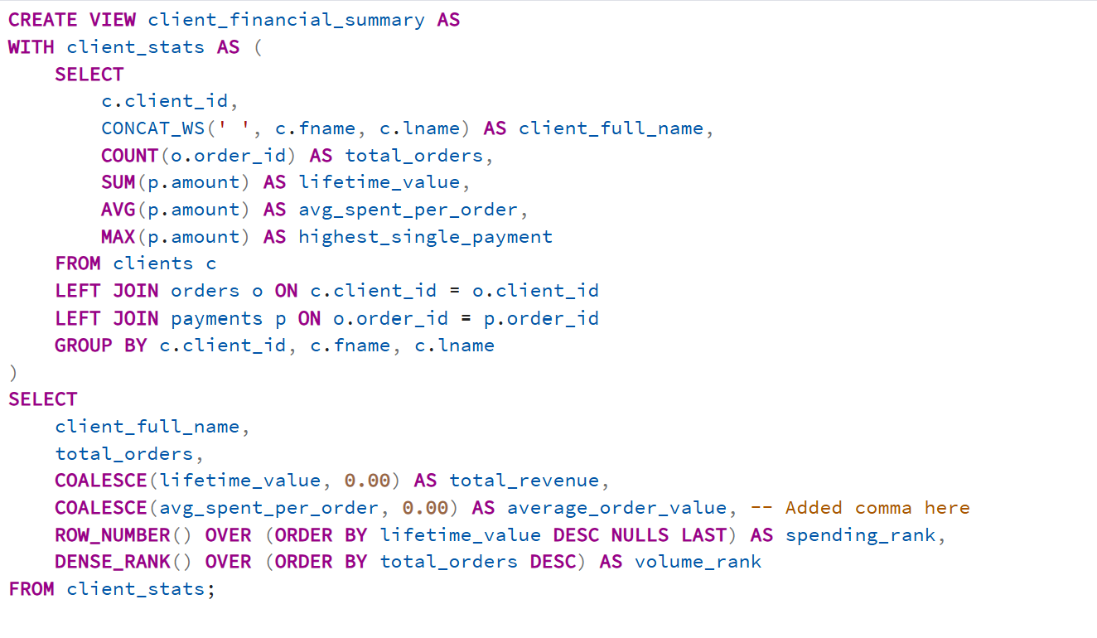
Queries Part 1

Slide 6
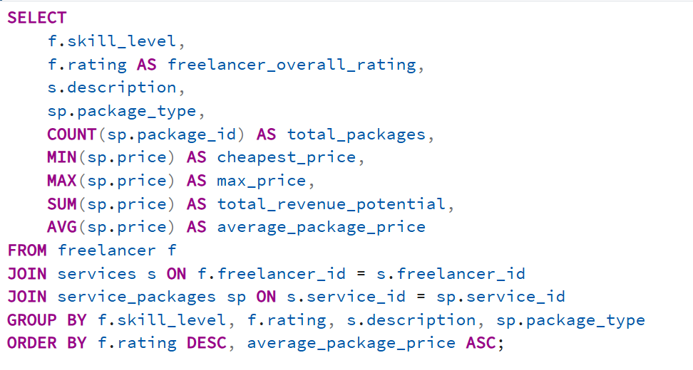
Queries part 2

Slide 7
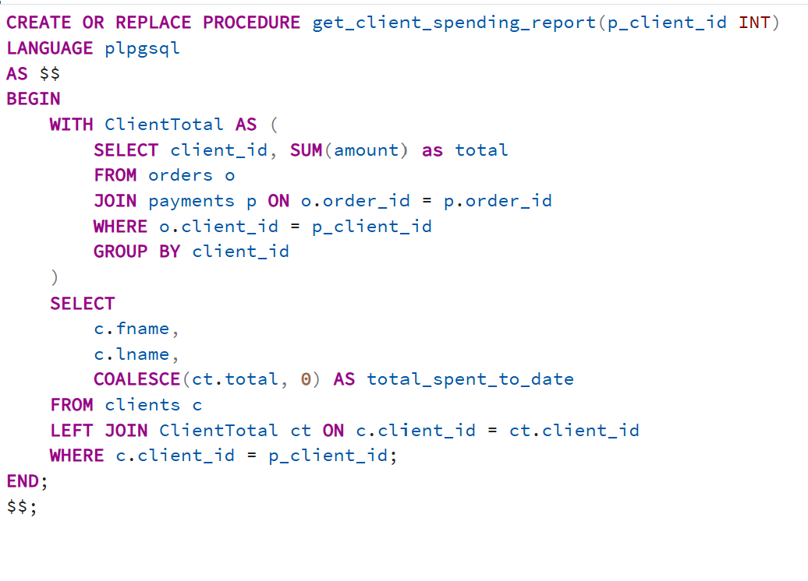
Queries part 3

Slide 8
Questions?
Thank you for listening!

